Slide 1

Swiggy Delivery Time Prediction using Machine Learning
Presented By : K. Sri Ram
Batch No : 436
Branch : Dilsukhnagar

Slide 2
About me:
I am Krishnasagarapu Sri Ram.
I have graduated with a B.Tech in Computer Science and Engineering (Data Science) from Vignana Bharathi Institute of Technology.
Linkedin : https://www.linkedin.com/in/sri-ram-krishnasagarapu-760a20239/
Github : https://github.com/Sriram943-collab

Slide 3
Problem Statement
Swiggy handles thousands of deliveries daily
Accurate ETA (Estimated Time of Arrival) is critical
Inaccurate delivery time leads to:
Customer dissatisfaction
Order cancellations
Refund costs
Reduced repeat orders
Business needs a predictive system to estimate delivery time at order placement
Goal: Build a reliable ML model to predict delivery time accurately.

Slide 4
Objective
Develop a supervised regression model
Use historical delivery data
Identify key factors affecting delay
Compare multiple algorithms
Select best performing model
Prepare system for deployment
Evaluation Metrics:
R² Score
RMSE

Slide 5
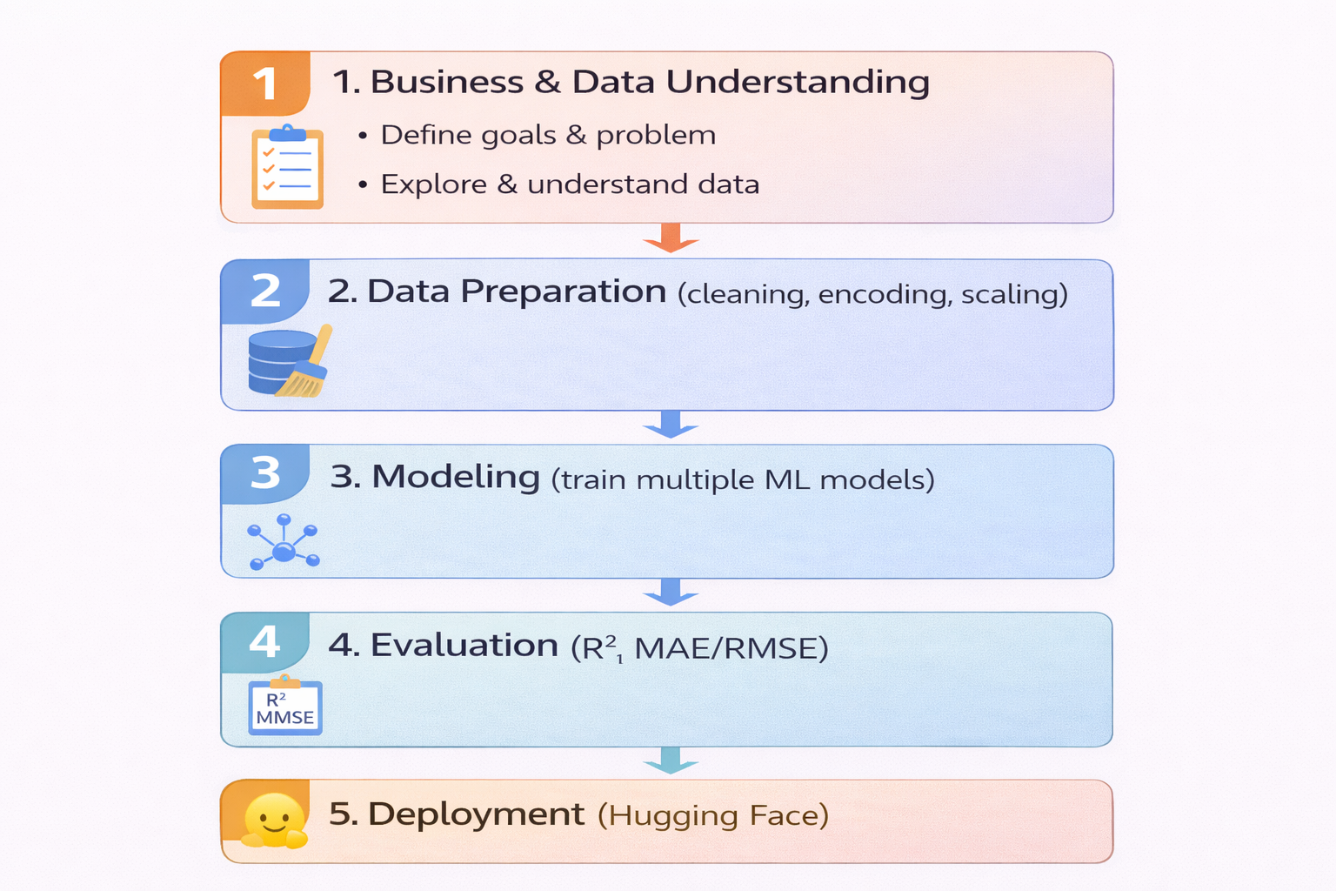
Methodology (CRISP-ML(Q))

Slide 6
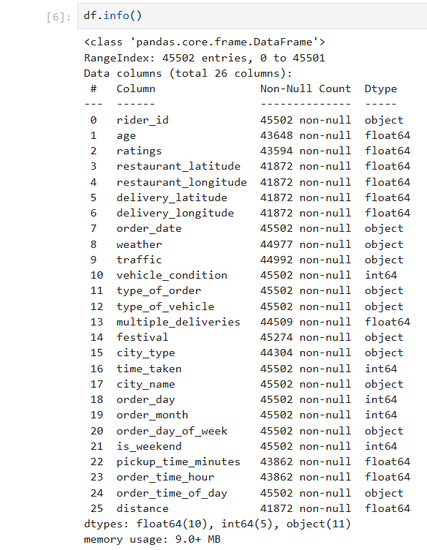
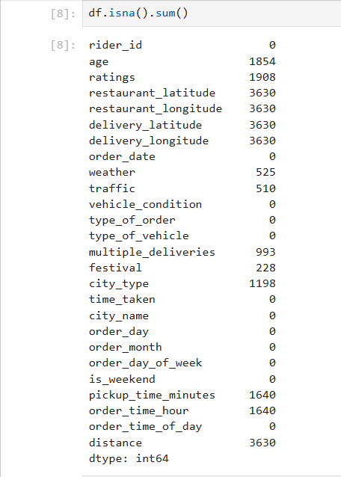
Data Understanding

Slide 7
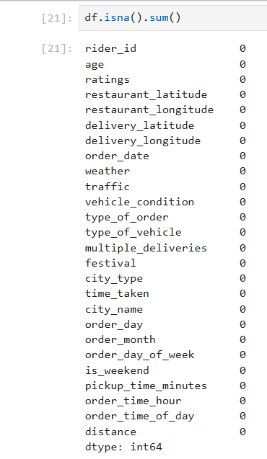

Data Cleaning
Numerical rider features were filled using mean to preserve rider behavior. For workload-related feature like multiple deliveries, we used median to avoid skew. Categorical variables were filled using mode.

Slide 8
Encoding
Converted categorical data into numerical form.
One-Hot Encoding applied to nominal features such as weather, vehicle type, order type, city, and time of day.
Ordinal Encoding applied to traffic since it has natural order (low → jam).
Removed original categorical columns after encoding.
Ensured model compatibility with machine learning algorithms.

Slide 9
Feature Scaling
Applied StandardScaler to normalize numerical features.
Purpose:
• Bring features to common scale
• Improve convergence for linear models
• Reduce dominance of large-range features

Slide 10
Feature Selection
Applied multiple techniques to identify important predictors:
Correlation analysis with target variable
SelectKBest (f_regression) for statistical relevance
Mutual Information for capturing non-linear relationships
Final selected features included: distance, traffic, multiple_deliveries, ratings, festival, order_time_hour, vehicle_condition
Reduced dimensionality improved model stability and performance.

Slide 11
Train–Test Split
• Divided dataset into 80% Training and 20% Testing data.
• Training set used to learn patterns from historical delivery data.
• Testing set used to evaluate model performance on unseen data.
• Prevented overfitting by evaluating model only on test data.

Slide 12
Model Building
Built and compared multiple regression models:
Linear Regression Decision Tree KNN Random Forest
Evaluation Metric: R² Score
Random Forest showed superior performance due to ensemble learning capability.

Slide 13
Cross Validation
Used 5-Fold Cross Validation:
Ensured consistent performance
Reduced dependency on single train-test split
Verified model generalization
Random Forest showed stable R² across folds.

Slide 14
Hyperparameter Tuning
Optimized model performance using:
GridSearchCV (exhaustive search)
RandomizedSearchCV (efficient search)
Tuned parameters: n_estimators, max_depth, min_samples_split, min_samples_leaf, max_features
Selected best combination based on highest cross-validation score.

Slide 15
Model Evaluation
• Evaluated model performance using three metrics:
– R² Score – RMSE (Root Mean Squared Error) – MAE (Mean Absolute Error)
R² shows how much variance in delivery time is explained by the model.
RMSE measures average prediction error in minutes (penalizes large errors more).
MAE measures average absolute difference between predicted and actual time.
Random Forest achieved strong R² with low RMSE and MAE, indicating reliable predictions.

Slide 16
Final Model & Performance
Final Model: Tuned Random Forest Regressor
Trained using selected important features
Achieved stable R² ≈ 0.76
Demonstrated strong predictive capability
Suitable for real-time ETA estimation

Slide 17
Business Impact
Improved ETA accuracy
Reduced customer cancellations
Enhanced rider allocation efficiency
Scalable ML solution for production integration

Slide 18

THANK YOU

